Slide 1
Assalamualaikum

Slide 2
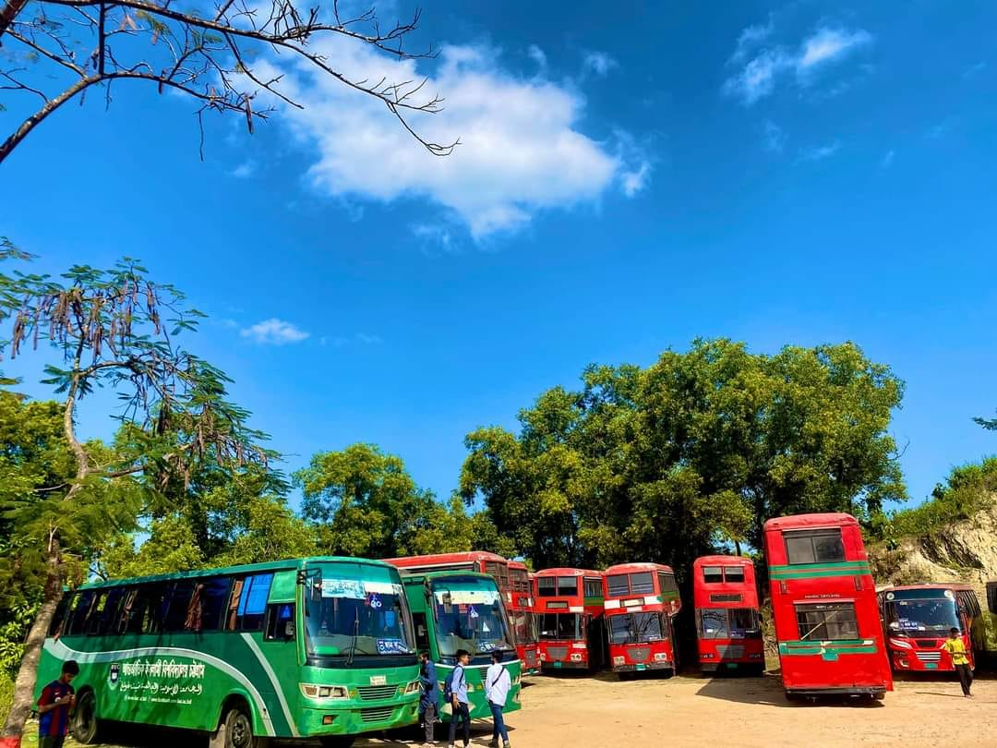
IIUC Transport System
This project will be built by using oop in C++, Presented by
Salman Samir (C241259)
Musfek Uddin (C241265)
Sakibul Islam Sakif (C241268)

Slide 3
Features
Real-Time Tracking (Simulated)
- Simulates vehicle locations using periodic updates.
Reservation System
- Allows students to book seats for specific schedules.
User Management
- Creates profiles with different access levels for students, staff, and visitors.
Emergency Notifications
- Notifies users of delays, breakdowns, or schedule changes.
Maintenance Scheduling
- Schedules vehicle maintenance based on usage or time intervals.
Feedback System
- Enables users to provide feedback on services.
Route Optimization
- Suggests optimal routes based on traffic, time, or user density.

Slide 4
OOP Concepts Used
Classes and Objects
Inheritance
Polymorphism
Encapsulation
Abstraction

Slide 5
Key Functionalities
Adding and managing vehicles.
Creating and managing routes.
Scheduling and tracking transportation.
User interface for interacting with the system.

Slide 6
Conclusion
The transport system project uses object-oriented design to efficiently manage users, vehicles, routes, and drivers. It is flexible, scalable, and models real-world transport management effectively.

Slide 7
"Thank You "

